Slide 1

Software Engineering (CS3201) Agile Methodologies
Avinash

Slide 2

Some artefacts (for course project)
Statement of Work Template: Available here

Slide 3
Process Models... continued

Slide 4
Agile Software Development (Process)
Agile Processes (Agile methods)
Extreme Programming
Scrum
DSDM (Refer Pressman, pg. 79)

Slide 5
Introduction
Businesses now operate in a global, rapidly changing environment
Rapid software development and delivery is therefore the most critical requirement for most business systems
In a changing environment, it is impossible to derive a complete set of stable software requirements
It may only be after a system has been delivered and users gain experience with it that the real requirements become clear
As the requirements change or as requirements problems are discovered, the system design or implementation has to be reworked
Conventional waterfall or specification-based process usually becomes a lengthy one

Slide 6
Introduction
For some types of software, such as safety-critical control systems, where a complete analysis of the system is essential, this plan-driven approach is the right one
For fast moving businesses, by the time the software is available for use, the original reason for its procurement may have changed so radically that the software is effectively useless
Therefore, for business systems in particular, development processes that focus on rapid software development and delivery are essential
Agile methods are designed to produce useful software quickly

Slide 7
Agile Method characteristics
The processes of specification, design and implementation are interleaved. There is no detailed system specification, and design documentation is minimized or generated automatically (by using certain tools)
User requirements document is an outline definition of the most important characteristics of the system
System is developed in a series of increments. End users and other stakeholders involved in specifying and evaluating each increment
Extensive tool support is used to support the development process (examples: Automated testing tools, configuration management, system integration)

Slide 8
Agile Methods
Incremental development methods
Increments are small, and, typically, new releases of the system are created and made available to customers every two or three weeks
Customers involved in development - rapid feedback on changing requirements
Minimize documentation by using informal communications rather than formal meetings with written documents
Consider design and implementation to be the central activities
Notes:
For hardware development, where high manufacturing costs are involved, this makes sense. However, for software development, these stages overlap and feed information to each other. During design, problems with requirements are identified; during coding design problems are found, and so on. The software process, in practice, is never a simple linear model but involves feedback from one phase to another

Slide 9
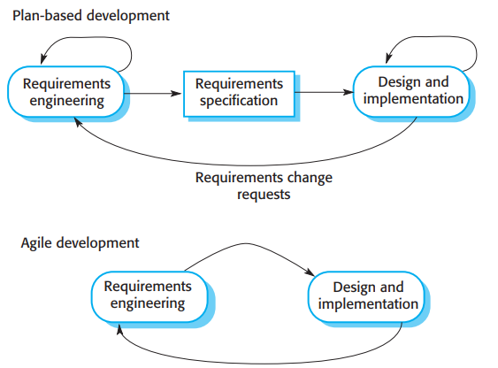
Agile Method vs. Plan based methods
In plan-based development, iterations happen within phases / activities
Possible to use agile practices along with plan based processes
In Agile, iterations happen across phases / activities

Slide 10
Agile Methods vs. Plan based methods
Plan based software development
Came from a software engineering community that was responsible for developing large, long-lived software systems such as aerospace or government systems
Usually large teams across different companies
Time: Might take even 10 years from initial plan to deployment
Overhead in planning but justified by system criticality and coordination
Agile:
For small and medium businesses, overhead in plan-based approach dominates actual software development process
Focus on software, requirements change as software develops
Deliver working software quickly, new and changed requirements in future iterations
Agile Manifesto

Slide 11
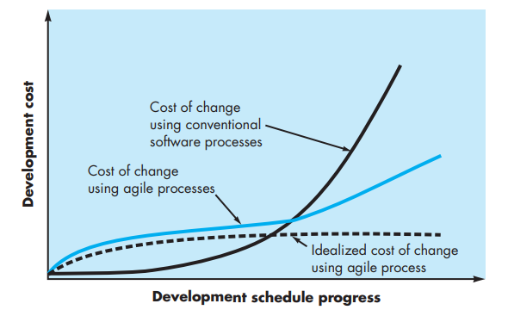
Change costs as a function of time: Agile vs. Plan based

Slide 12
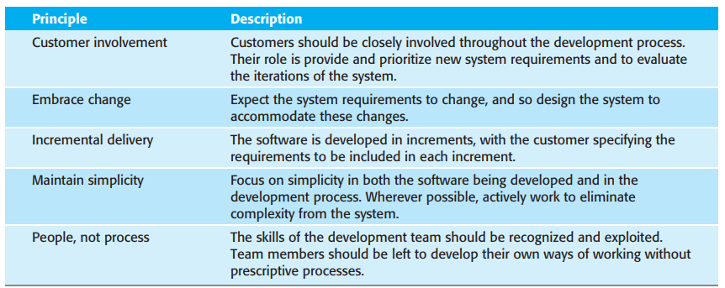
Principles of Agile Methods (Som., pg. 76)

Slide 13
Agile Methods: Usage
Agile methods have been particularly successful for two kinds of system development:
Product development where a software company is developing a small or medium-sized product for sale. Virtually all software products and apps are now developed using an agile approach
Custom system development within an organization, where there is a clear commitment from the customer to become involved in the development process and where there are few external stakeholders and regulations that affect the software
Agile methodology works (best) when the software itself is a stand-alone system rather than tightly integrated with other systems being developed at the same time. Consequently, there is no need to coordinate parallel development streams
Notes:
The problems of incremental development become particularly acute for large, complex, long-lifetime systems, where different teams develop different parts of the system. Large systems need a stable framework or architecture, and the responsibilities of the different teams working on parts of the system need to be clearly defined with respect to that architecture. This has to be planned in advance rather than developed incrementally. Incremental development does not mean that you have to deliver each increment to the system customer. You can develop a system incrementally and expose it to customers and other stakeholders for comment, without necessarily delivering it and deploying it in the customer’s environment. Incremental delivery (covered in Section 2.3.2) means that the software is used in real, operational processes, so user feedback is likely to be realistic. However, providing feedback is not always possible as experimenting with new software can disrupt normal business processes.

Slide 14
Agile Manifesto
"We are uncovering better ways of developing software by doing it and helping others do it. Through this work we have come to value:
Individuals and interactions over processes and tools
Working software over comprehensive documentation
Customer collaboration over contract negotiation
Responding to change over following a plan
That is, while there is value in the items on the right, we value the items on the left more."
Notes:
The problems of incremental development become particularly acute for large, complex, long-lifetime systems, where different teams develop different parts of the system. Large systems need a stable framework or architecture, and the responsibilities of the different teams working on parts of the system need to be clearly defined with respect to that architecture. This has to be planned in advance rather than developed incrementally. Incremental development does not mean that you have to deliver each increment to the system customer. You can develop a system incrementally and expose it to customers and other stakeholders for comment, without necessarily delivering it and deploying it in the customer’s environment. Incremental delivery (covered in Section 2.3.2) means that the software is used in real, operational processes, so user feedback is likely to be realistic. However, providing feedback is not always possible as experimenting with new software can disrupt normal business processes.

Slide 15
Agile Methods
Extreme Programming (XP)
Scrum
DSDM

Slide 16
Extreme Programming (XP)
Most significant approach to changing software development culture
Pushing recognized software good practices (such as iterative development) to the extreme (An example of extreme: Several new versions of a system may be developed by different programmers, integrated, and tested in a day)

Slide 17
Extreme Programming (XP)
In XP:
Requirements are expressed as scenarios (called user stories)
Implemented directly as a series of tasks
Programmers work in pairs and develop tests for each task before writing the code
All tests must be successfully executed when new code is integrated into the system
There is a short time gap between releases of the system

Slide 18
XP Process
Planning:
XP Release Planning
Identify requirements in the form of stories
Prioritize them
Group them into releases.
XP Iteration Planning
Each iteration delivers a group of stories
Estimate project velocity (total number of story points, estimate of number of work done)
Plan the overall project deadline based on the velocity (possible from 2nd iteration onwards)

Slide 19
XP Process
Design:
Build Task cards
Build Class-Responsibility-Collaborator (CRC) cards
CRC cards identify and organize the object-oriented classes
Create prototypes to address difficult designs
Prototype is called spike solution
Coding:
Develop test cases first.
Programmers code with test cases in view
Pair programming
Ensures real time problem solving and quality assurance
Code is integrated at the end of the day with that of others

Slide 20
XP Process
Testing:
Focus on XP acceptance tests also called customer tests
Acceptance tests are derived from user stories
Verification and Validation
Building the product right Vs building the right product
Release:
Software increment decided (what features are to be implemented in the next iteration are decided)
Velocity computed (helps plan for the next release)

Slide 21
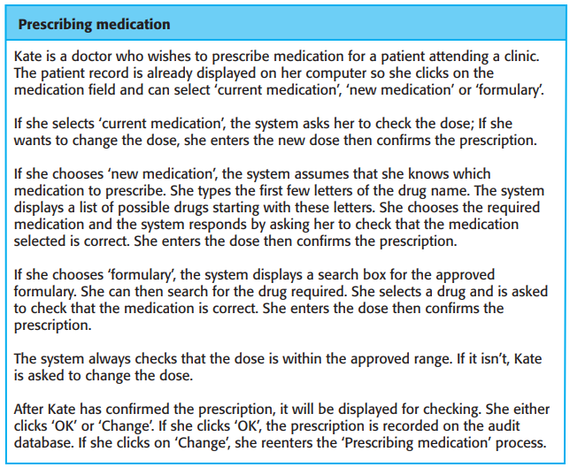
XP Components Story
In the Extreme Programming (XP) process model, a story (also known as a user story) is a short, simple description of a feature or functionality that the system should provide. It’s written from the perspective of the end user or customer and focuses on what the user wants to achieve rather than how it will be implemented.
Notes:
Key Characteristics of a Story:
User-Centric:
Describes a feature in terms of the user’s needs.
Written in natural language, avoiding technical jargon.
Simple and Concise:
Typically fits on an index card or a few lines of text.
Focuses on a specific goal or task.
INVEST Criteria (Good User Stories):
Independent: Can be developed separately from other stories.
Negotiable: Flexible for discussions and refinements.
Valuable: Provides clear value to the user or customer.
Estimable: Can be estimated in terms of effort or time.
Small: Manageable within a single iteration.
Testable: Clear criteria to verify its completion.
Structure of a User Story:
The common template is:
“As a [type of user], I want [an action or feature] so that [desired outcome].”
Examples (Sustainable Shopping Assistant App):
Barcode Scanning:
"As a shopper, I want to scan a product’s barcode so that I can instantly see its sustainability rating."
Eco-Friendly Suggestions:
"As a conscious consumer, I want to receive eco-friendly product suggestions based on my purchases so that I can make more sustainable choices."
Carbon Footprint Analysis:
"As a user, I want to upload my supermarket bills so that the app can analyze my ecological footprint."

Slide 22
XP Components: Story
The common template is:
“As a [type of user], I want [an action or feature] so that [desired outcome].”
Examples (Sustainable Shopping Assistant App):
Barcode Scanning:
"As a shopper, I want to scan a product’s barcode so that I can instantly see its sustainability rating."
Eco-Friendly Suggestions:
"As a conscious consumer, I want to receive eco-friendly product suggestions based on my purchases so that I can make more sustainable choices."
Carbon Footprint Analysis:
"As a user, I want to upload my supermarket bills so that the app can analyze my ecological footprint."

Slide 23
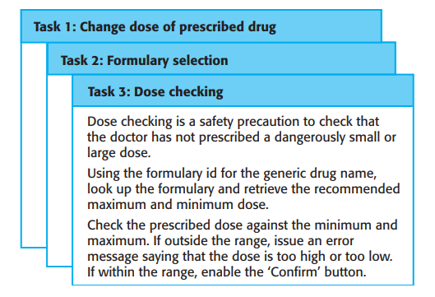
XP Components Task cards
In Extreme Programming (XP), task cards are used to break down user stories into smaller, manageable units of work called tasks. While user stories describe what the user wants, task cards focus on how to implement those features from a technical perspective.

Slide 24
XP Process Components – Task cards
Key Characteristics of Task Cards:
Implementation-Focused:
Each task card describes a specific technical activity needed to complete a user story.
Example: “Design the database schema for storing product sustainability data.”
Small and Manageable:
Tasks should be small enough to be completed within a few hours to a day.
This makes tracking progress easier during iterations.
Linked to User Stories:
Every task card is associated with a specific user story, ensuring that all technical work directly contributes to delivering user value.
Written by Developers:
Unlike user stories, which are often written by customers or product owners, task cards are usually created by the development team during iteration planning

Slide 25
Example: Sustainable Shopping Assistant App
User Story:
"As a shopper, I want to scan a product’s barcode so that I can instantly see its sustainability rating."
Associated Task Cards:
Integrate Barcode Scanner API
Set up the barcode scanning library and test device compatibility.
Estimate: 4 hours
Develop UI for Scanning Screen
Design and implement the screen where users scan barcodes.
Estimate: 3 hours
Connect Scanner to Database
Ensure scanned barcodes fetch sustainability data from the database.
Estimate: 5 hours
Implement Error Handling for Invalid Barcodes
Display appropriate messages when a barcode isn’t recognized.
Estimate: 2 hours

Slide 26
XP Process Components – Velocity
Key Aspects of Velocity:
Definition:
Velocity represents the sum of effort estimates (usually in story points, ideal days, or hours) for all the user stories or tasks that a team completes in an iteration
It reflects the team’s productivity and capacity
How It's Measured:
At the end of each iteration, the team adds up the effort estimates of fully completed work items
For example, if a team completes stories worth 20, 15, and 10 story points, their velocity for that iteration is 45 story points

Slide 27
XP Process Components – Velocity example
Example (Sustainable Shopping Assistant App):
Iteration 1:
Barcode Scanner Feature (8 story points) ✔
Product Sustainability Database (13 story points) ✔
Eco-Friendly Product Suggestions (5 story points) ❌ (not completed)
Velocity: 8 + 13 = 21 story points for Iteration 1
For a full example, refer here

Slide 28
XP Process Components – CRC cards
Key Components of CRC Cards:
Class:
Represents an object or entity in the system.
The name of the class is written at the top of the card.
Example: Product, User, Order.
Responsibilities:
Defines what the class is supposed to do—its duties, behaviors, or functions.
Example: For a Product class, responsibilities could be "calculate price with discount" or "update stock quantity."
Collaborators:
Lists other classes that this class interacts with to fulfill its responsibilities.
Example: A ShoppingCart class might collaborate with the Product and Payment classes

Slide 29
XP Process Components – Pair Programming
Pair Programming is a core practice in Extreme Programming (XP) where two developers work together at one workstation to write code. It’s designed to improve code quality, encourage collaboration, and enhance problem-solving through real-time feedback and shared knowledge
Details (2-page handout) of pair programming: here

Slide 30
XP Process Components – Test case description
In Extreme Programming (XP), test cases are an integral part of the development process, especially because XP heavily relies on Test-Driven Development (TDD). Test cases in XP are often written before the actual code to ensure that the code meets the desired requirements and behaves as expected.
Details (2-page handout) of pair programming: here

Slide 31
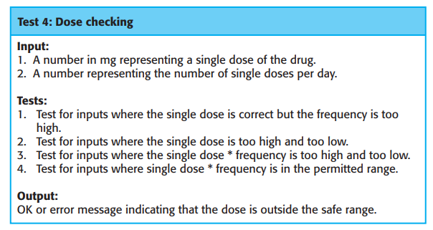
XP Components: Test case description

Slide 32
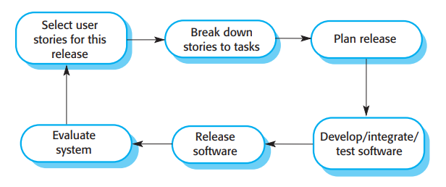
XP Release Cycle
Note (my 2 cents): The term 'release' here is slightly confusing. Release generally consists of multiple iterations, where each iteration is a phase where some part of the product is built. You can think of an iteration as an increment. Therefore, read 'release' as 'iteration' in this graph.

Slide 33
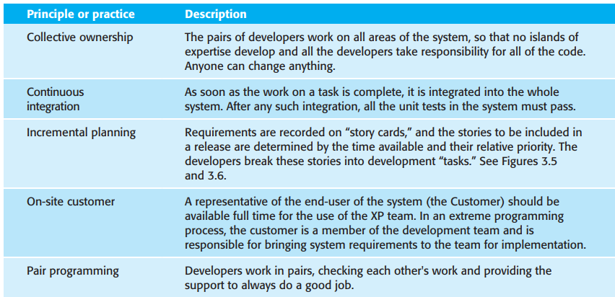
XP Practices

Slide 34
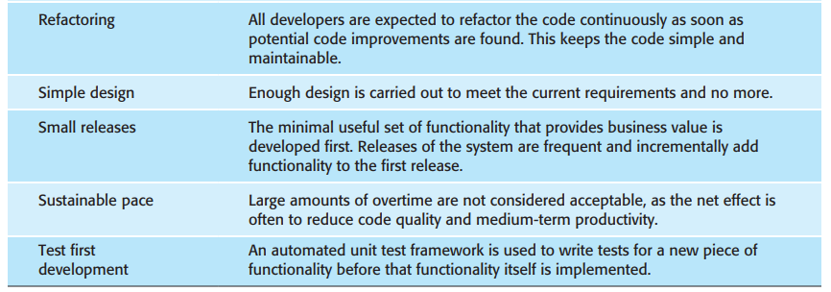
XP Practices

Slide 35
XP Closing thoughts
In practice, the application of Extreme Programming as originally proposed has proved to be more difficult than anticipated
It cannot be readily integrated with the management practices and culture of most businesses. Therefore, companies adopting agile methods pick and choose those XP practices that are most appropriate for their way of working
Sometimes these are incorporated into their own development processes but, more commonly, they are used in conjunction with a management focused agile method such as Scrum (Rubin 2013).

Slide 36
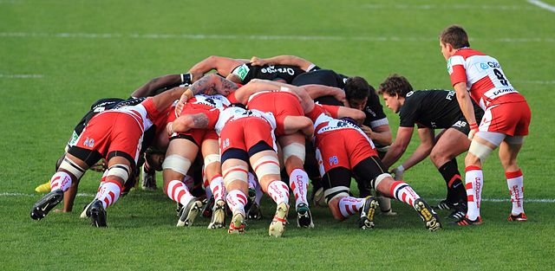
Scrum

Slide 37
Agile Project Management.. Scrum.. Introduction
In any software business, managers need to know what is going on and whether a project is likely to meet its objectives (and deliver the project on time)
Plan-driven approaches to software development evolved to meet this need
XP based approaches do not cater to the point above
A plan-based approach requires a manager to have a stable view of everything that must be developed and the development processes
The informal nature of early agile methods clashed with the business requirement for visibility
While this can and does work for small companies developing software, it is inappropriate for larger companies

Slide 38
Agile Project Management.. Scrum.. Introduction
To address the issues mentioned in the previous slide(s), Scrum agile method was developed
Scrum developed to "provide a framework for organizing agile projects and, to some extent at least, provide external visibility of what is going on"
Therefore, it is called a plan-based agile approach
Developers of scrum wished to make it clear that is not a method for project management in the conventional sense, therefore, you have new terminology (which you will see in due course)
Scrum follows the principles of Agile development, however,
It provides a framework for Agile Project Organization, and does not mandate specific practices (like pair programming, for instance) - meaning, can be integrated more easily with existing company policies

Slide 39
SCRUMptious? Whet your appetite up to some study?
Where do we start? Let's start at the very beginning... In the beginning, there was a need to eat... food... it started simple enough, foraging for small animals, plants... Hit Fast Forward 2 million years... priorities have changed, we start with the 'Product Backlog'
'Product backlog' - The input to the scrum process
Product backlog is a list of to-do items that are needed for the product
Okay, this is not working, let me try another approach – let's look at an image explaining the overall scrum ideology
Notes:
While the majority of entries in the product backlog are concerned with the implementation of system features, other activities may also be included. Sometimes, when planning an iteration, questions that cannot be easily answered come to light and additional work is required to explore possible solutions. The team may carry out some prototyping or trial development to understand the problem and solution. There may also be backlog items to design the system architecture or to develop system documentation
The product backlog can be the list of items such as product features, requirements, and engineering improvement that have to be worked on by the Scrum team
The initial product backlog can be derived from requirements document, user stories, or any other stories of the software being developed

Slide 40
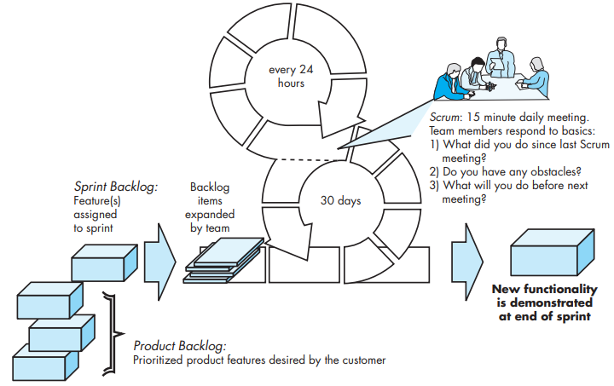
Scrum process flow (Pressman, pg. 78)

Slide 41
SCRUM – Setting the environment
Roles – Product owner, Scrum Master, Team
Ceremonies – Sprint planning, Sprint review, Sprint retrospective, Daily Scrum meeting
Artifacts – Product backlog, Sprint backlog, Burndown chart
Some people tend to use the term 'Sprint Meeting', however, in reality, there is no 'sprint meeting' and instead sprint planning (what to do in a sprint), sprint review (what did we build) and sprint retrospective (how did we build, how was our process) are various meetings that happen during a sprint.
A lot of sprinting around! Very healthy!
A sprint is nothing but a period (of time), where some pre-defined tasks are completed.

Slide 42
SCRUM – Roles
For more on Product Owner and Scrum Master, refer
What is a scrum master and their responsibilities?
Product Owner:
Defines product features, release date and content, responsible for profitability of product (ROI), prioritize features, create product backlog
Primary Point of Contact with the customer (and represents the customer)
Scrum Master:
Represents management side (and what do managers do – ensure productivity, following of practices, coordination and cooperation)
Scrum Team:
5 - 10 people (typically), Cross functional (Each member provides a variety of skills - QA, Programmers, UI designers, etc.), Members should be full time (usually), highly collaborative, empowered (team members have the authority to make decisions), transparent (work in the open and understood across all in the team)

Slide 43
SCRUM – Artifacts
Product Backlog:
"The product backlog is a dynamic, prioritized list of all the features, functions, requirements, enhancements, and fixes necessary for a project."
"product backlog helps prioritize and organize project requirements"
The list is prioritized by Product Owner
Usually the list consists of story-based work ("let the user search") and task-based work ("we should handle exceptions")
Usually created before the 'Sprint planning' meeting
Can be changed and re-prioritized before each Sprint Planning
More can be found here: Product and Sprint Backlog

Slide 44
SCRUM – Artifacts
Sprint Backlog:
It is a curated list of items the development team commits to completing during a sprint
Breaks down the selected product backlog into actionable tasks that can be taken in a sprint
Also helps provide a clear sprint plan
Sprint backlog is usually created during the 'Sprint Planning' meeting
Is flexible and allows change – can add new tasks to meet goals, remove unnecessary tasks
Can be updated only by the scrum team
More can be found here: Product and Sprint Backlog

Slide 45
SCRUM – Artifacts
An example of Product backlog and Sprint backlog (the tasks under a product backlog):
1. Redesign the checkout page (Product backlog)
Task 1.1: Conduct user research to identify pain points (Assigned: User experience researcher, eight hours)
Task 1.2: Create wireframes (Assigned: UI designer, 16 hours)
Task 1.3: Develop frontend code (Assigned: Frontend developer, 24 hours)
Task 1.4: Integrate with backend (Assigned: Backend developer, 16 hours)
Task 1.5: Conduct usability testing (Assigned: QA engineer, eight hours)

Slide 46
SCRUM – Artifacts
Differences between product and sprint backlogs
 | Product Backlog | Sprint Backlog
Scope and Purpose | long-term, prioritized list of all features, enhancements, and fixes necessary for the product | subset of the product backlog. It focuses on the tasks and goals necessary to complete within a single sprint and provides a detailed, short-term plan
Ownership and Responsibility | product owner owns and manages the product backlog | development team owns the sprint backlog and handles the task breakdown and execution
Level of Detail | Less granular | More granular
Flexibility | More flexible | Less flexible

Slide 47
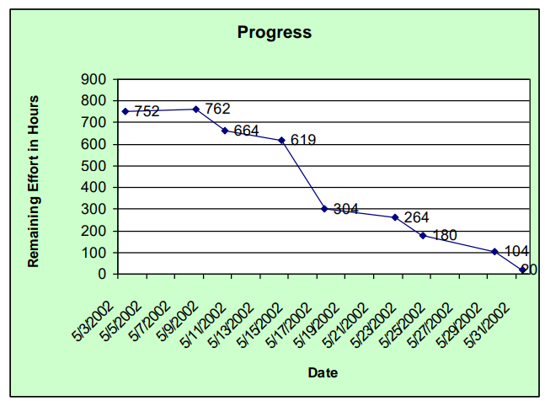
SCRUM – Artifacts
Sprint burn down chart
Depicts the total Sprint Backlog hours remaining per day
Shows the estimated amount of time to release
Ideally should burn down to zero to the end of the Sprint
Is usually not a straight line

Slide 48
SCRUM – Ceremonies
Sprint Planning:
1st Part:
Participants: Product Owner, Scrum Master, Scrum Team
Creating Product Backlog
Determining the Sprint Goal
2nd Part:
Participants: Scrum Master, Scrum Team
Creating Sprint Backlog
The whole team is involved in selecting which of the highest priority items they believe can be completed
To make these estimates, they use the velocity attained in previous sprints, that is, how much of the backlog could be covered in a single sprint
This leads to the creation of a sprint backlog—the work to be done during that sprint

Slide 49
SCRUM – Ceremonies
Sprint:
A month-long iteration, during which is a product functionality is implemented (SOM. says 2-4 weeks)
NO outside influence can interfere with the Scrum team during the Sprint
Each Sprint begins with the Daily Scrum Meeting (which then happens every day)
Note: Sprints are never extended to take account of unfinished work
Items that cannot be completed are returned to the product backlog

Slide 50
SCRUM – Ceremonies
Daily Scrum Meeting:
Parameters – Daily, 15-minutes, Stand-up (also called a Huddle), Not for problem solving
Three questions:
What did you do yesterday?
What will you do today?
What obstacles are in your way?
Is NOT:
a problem-solving session (though sometimes discussions on problems do happen)
a way to collect information about WHO is behind the schedule
Is:
meeting in which team members make commitments to each other and to the Scrum Master
a good way for a scrum master to keep track of the work going on

Slide 51
SCRUM – Ceremonies
Sprint Review:
Team presents what it accomplished during the sprint
Typically takes the form of a demo of new features or underlying architecture
Informal: 2-hour prep time rule
Participants:
Customers
Management
Product Owner
Other engineers
Sprint Retrospective Meetings:
Scrum team only
Feedback meeting (Start, stop, continue)
Notes:
At the end of each sprint, there is a review meeting, which involves the whole team. This meeting has two purposes. First, it is a means of process improvement. The team reviews the way they have worked and reflects on how things could have been done better. Second, it provides input on the product and the product state for the product backlog review that precedes the next sprint
While the ScrumMaster is not formally a project manager, in practice ScrumMasters take this role in many organizations that have a conventional management structure. They report on progress to senior management and are involved in longer-term planning and project budgeting

Slide 52
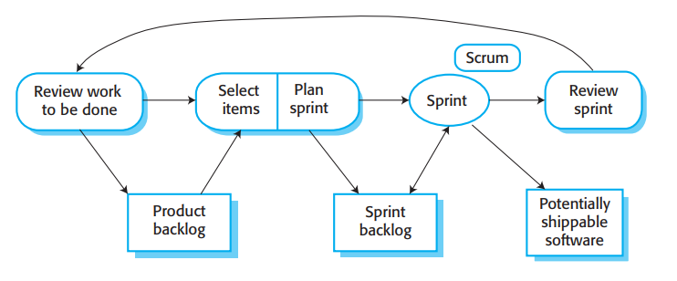
Scrum sprint cycle (SOM., pg. 86)

Slide 53
What people like about scrum? (SOM., pg. 87)
The product is broken down into a set of manageable and understandable chunks
Unstable requirements do not hold up progress
The whole team has visibility of everything
Customers see on-time delivery of increments and gain feedback on how the product works
Trust between customers and developers is established

Slide 54
Thank you!

